Slide 1
Fraud Detection and Prevention For Online Payments
Steven Swee

Slide 2
Why fraud detection?

Slide 3
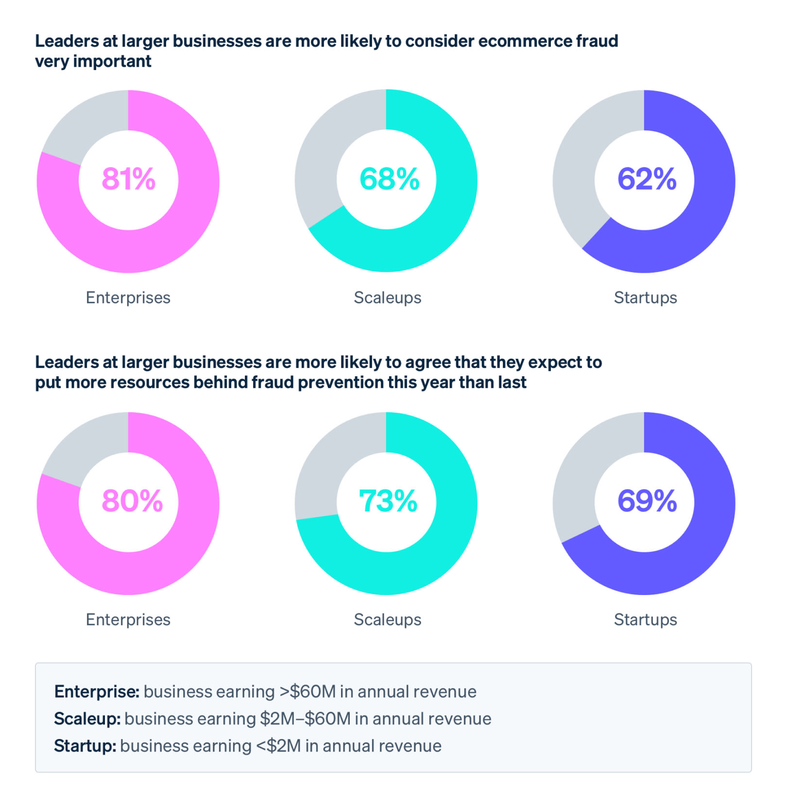
Where is this useful?

Slide 4
Where is this useful?
Bottom Line:
As businesses grow over time, they need to be able to handle fraudulent transactions

Slide 5
Where is this useful?
Bottom Line:
As businesses grow over time, they need to be able to handle fraudulent transactions
Focus:
Credit Card Transactions

Slide 6
Solution Overview

Slide 7
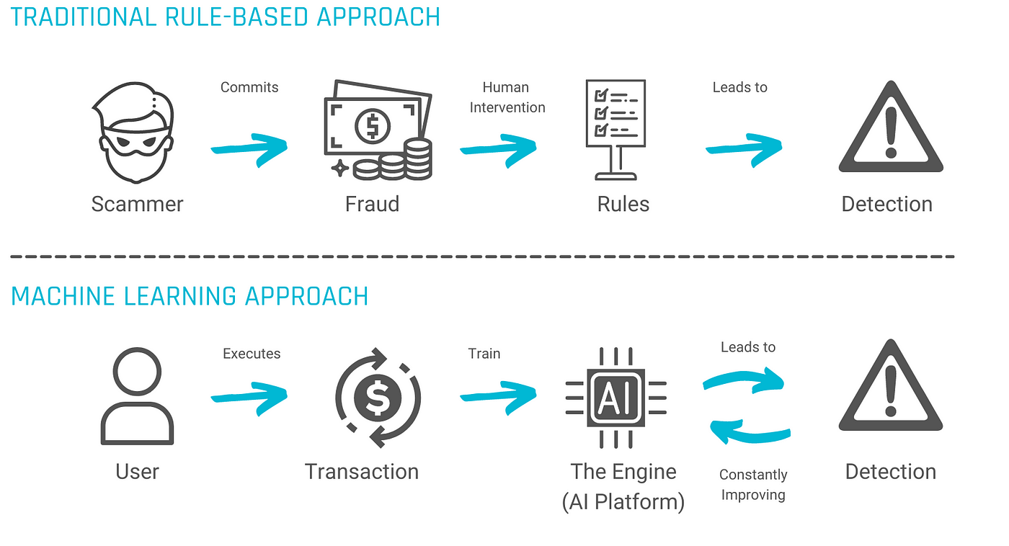

Slide 8
Determine/Understand Rules

Slide 9
Determine/Understand Rules
Find out where Machine Learning can be useful

Slide 10
Approach
Notes:
Image sources:
https://libguides.reading.ac.uk/food-research-project/literature-review
https://www.statice.ai/post/what-is-synthetic-data-introduction
https://colab.research.google.com/

Slide 11
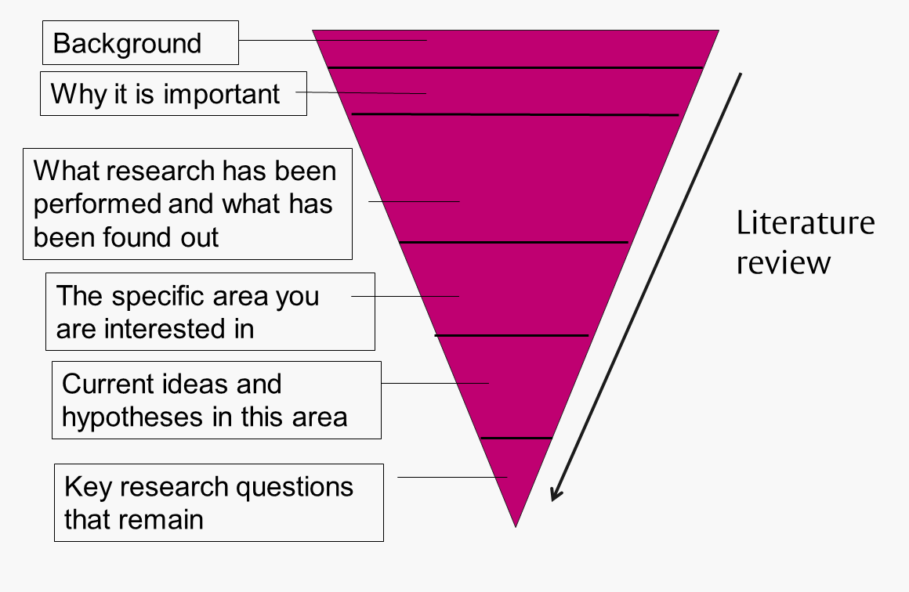
Approach
Notes:
Image sources:
https://libguides.reading.ac.uk/food-research-project/literature-review
https://www.statice.ai/post/what-is-synthetic-data-introduction
https://colab.research.google.com/

Slide 12
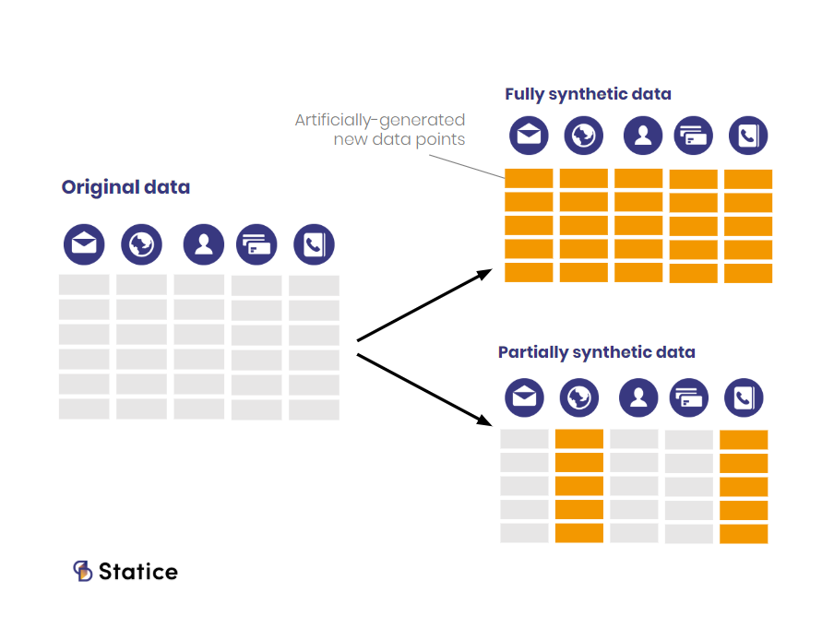
Approach
Notes:
Image sources:
https://libguides.reading.ac.uk/food-research-project/literature-review
https://www.statice.ai/post/what-is-synthetic-data-introduction
https://colab.research.google.com/

Slide 13

Approach
Notes:
Image sources:
https://libguides.reading.ac.uk/food-research-project/literature-review
https://www.statice.ai/post/what-is-synthetic-data-introduction
https://colab.research.google.com/

Slide 14
Procedure

Slide 15
Procedure
Source:
Ahmed, M., Ansar, K., Muckley, C. B., Khan, A., Anjum, A., & Talha, M. (2021). A semantic rule based digital fraud detection. PeerJ. Computer science, 7, e649. https://doi.org/10.7717/peerj-cs.649

Slide 16
Procedure
Rules:
Increase risk value based on number of conditions satisfied
Source:
Ahmed, M., Ansar, K., Muckley, C. B., Khan, A., Anjum, A., & Talha, M. (2021). A semantic rule based digital fraud detection. PeerJ. Computer science, 7, e649. https://doi.org/10.7717/peerj-cs.649

Slide 17
Procedure
Rules:
Increase risk value based on number of conditions satisfied
Sufficiently high transaction amount
Odd hours (10pm-3am)
Repeated large transactions
Category of transaction
Source:
Ahmed, M., Ansar, K., Muckley, C. B., Khan, A., Anjum, A., & Talha, M. (2021). A semantic rule based digital fraud detection. PeerJ. Computer science, 7, e649. https://doi.org/10.7717/peerj-cs.649

Slide 18
Procedure
Rules:
Increase risk value based on number of conditions satisfied
Sufficiently high transaction amount
Odd hours (10pm-3am)
Repeated large transactions
Category of transaction
Based on risk value, alert user if transaction if fraudulent
Source:
Ahmed, M., Ansar, K., Muckley, C. B., Khan, A., Anjum, A., & Talha, M. (2021). A semantic rule based digital fraud detection. PeerJ. Computer science, 7, e649. https://doi.org/10.7717/peerj-cs.649

Slide 19
Procedure
Rules:
Increase risk value based on number of conditions satisfied
Sufficiently high transaction amount
Odd hours (10pm-3am)
Repeated large transactions
Category of transaction
Based on risk value, alert user if transaction if fraudulent
Difficulty lies within choosing ontologies and thresholds
Source:
Ahmed, M., Ansar, K., Muckley, C. B., Khan, A., Anjum, A., & Talha, M. (2021). A semantic rule based digital fraud detection. PeerJ. Computer science, 7, e649. https://doi.org/10.7717/peerj-cs.649

Slide 20
Determine/Understand Rules
Find out where Machine Learning can be useful
Value comes from making this approach dynamic

Slide 21
Demo

Slide 22
Future Directions
Validate current iteration of code onto test data
Implement different ontologies
Ex: Utilize recency to adjust threshold for a “sufficiently high amount”
Implement grid search to determine appropriate parameters
Use Machine Learning methods to improve efficiency
Goal: Make clearer distinction between fraud and not fraud
Test on real data from SMEs instead of synthetic data

Slide 23
Questions?

